Slide 1

AMAZON SALES DATA ANALYSIS REPORT:
Exploratory Data Analysis Project with POWER BI, SQL, EXCEL
INTERNSHIP PERIOD: 15 JULY – 15 AUGUST 2024
By
Arshpreet kaur
(Business Intelligence)

Slide 2
Introduction
systematic approach to gathering, examining, refining, converting, modeling, and explaining data to unveil valuable insights and facilitate decision-making.
Extraction of valuable insights from datasets through data analysis techniques, empowering them to make informed operational decisions and chart the course for future research.
utilized to extract valuable insights from datasets, which can then be used to inform operational decisions or steer future research.
proliferation of "big data," the storage of enormous amounts of data in extensive databases and data warehouses, has created a growing necessity to employ data analysis methods to derive insights from datasets that are too vast to be processed by systems with limited information-processing capabilities.

Slide 3
purpose
Identify Patterns and Trends
Inform Decision-Making
Solve problems
Optimize Performance
Aid in research
Validate Hypotheses
Develop a better comprehension
Forecast results

Slide 4
objective
This project explores amazon sales data to understand top-performing branches and products, sales trends of different products & customer behavior. The aim is to study how sales strategies can be improved and optimized. Vervebridge provided the data set to complete the project and extract various information. Here in this project, I developed a power BI dashboard to present insights into amazon sales trends, highlighting region-specific and item-specific sales analyses across different years, quarters, months, and days. This comprehensive dashboard offers detailed insights into various sales trends.

Slide 5

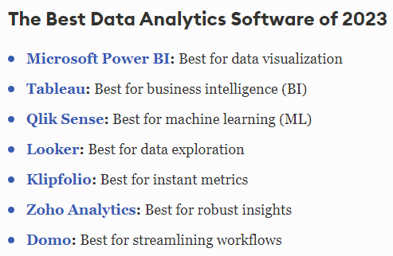
Source: https://www.forbes.com/advis or/business/software/best- data-analytics-tools/

Slide 6
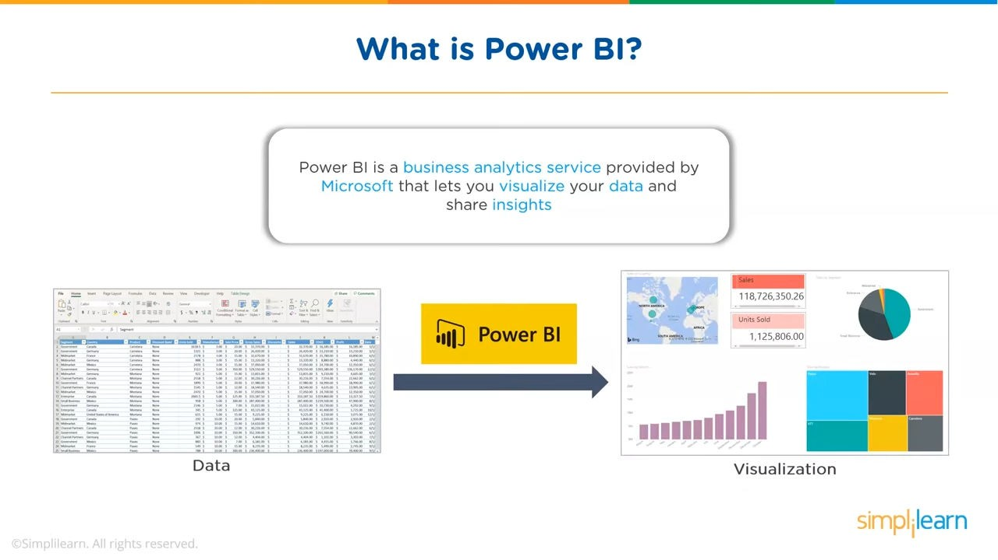

Slide 7
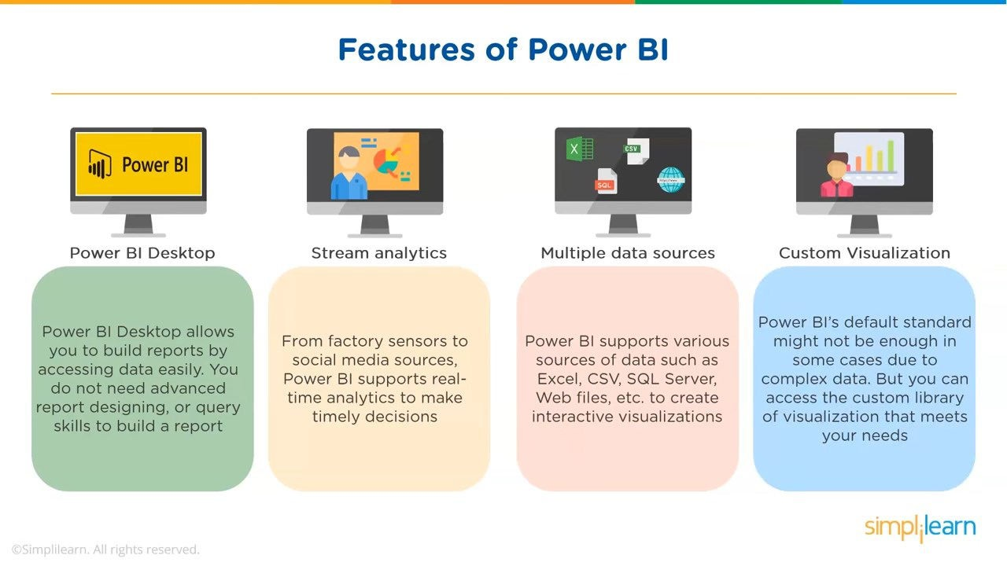

Slide 8










Top Companies Using Power BI
ADOBE
SIEMENS
COCACOLA
SHELL
AIRBUS
UNILEVER
AIRBUS
PEPSICO
H&M
DELL
ACCENTURE
Rolls-Royce

Slide 9
Problem Statement
Sales management has gained importance to meet increasing competition and the need for improved methods of distribution to reduce cost and to increase profits. Sales management today is the most important function in a commercial and business enterprise. Do ETL : extract-transform-load some amazon dataset and find sales-trend -> month wise , year wise , yearly month wise. Find key metrics and factors and show the meaningful relationships between attributes.
Tools used
Power BI, microsoft excel, mysql

Slide 10
Analysis List
Sales analysis
This analysis aims to answer the question of the sales trends of product. The result of this can help use measure the effectiveness of each sales strategy the business applies and what modificatoins are needed to gain more sales.
Product analysis
Conduct analysis on the data to understand the different product lines, the products lines performing best and the product lines that need to be improved.
Customer analysis
This analysis aims to uncover the different customers segments, purchase trends and the profitability of each customer segment

Slide 11
OVERALL ANALYSIS
total revenue: 2.72 T
No. of brands: 44k
No. of category: 129k
Total sales: 129k
Top 5 category of brands: zupaco, zutano, zunahme, zysta, Zzyzx/magic
Max brand by discount % counts to : 0.1-0.2%
Max delivery type: fulfilled by merchant- 87.76%
Left in stock by category max : womenswear

